Slide 1


Slide 2
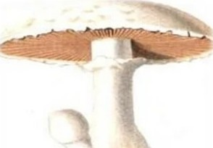

I nt rod uct io n
•• Mushroom is a fungi producing a fleshy fruiting body, 'especially one consisting of a stalk with an umbrella cap.
•• It has two part : cap like structure is known as PILEUS,
attached with thread like structure MYCELIA.
••Mycelia absorb nutrient from soil , it do not require sun light for their growth.

Slide 3
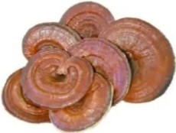
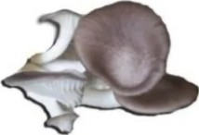
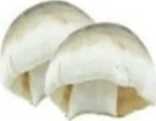
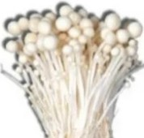
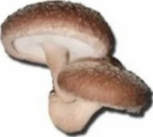
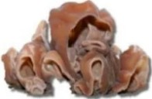
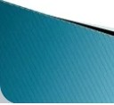

r
Ty pe s of M u s h roo ms
Oyster Mushroom
Straw Mushroom
Reishi Mushroom
Enokitake Mushroom
Shitake Mushroom
Wood Ear Mushroom

Slide 4

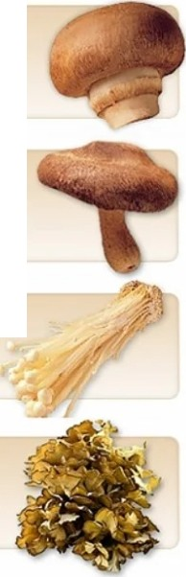
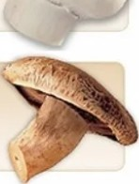
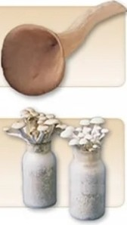
Ty p e s of Mus lh roo ms
White button
Themost popular mushroom,white buttons represent about 90 peroen1of mushrooms consumedin the United States
Crimini
Also knOl'm as baby 'betlas or browns. criminis are similar an appearance towhites,bU1 have a hght tanto nch·brovm cap and a firmer texture.
Portabella
Alarger relative ol criminis. F>011abeftas have tan or brown caps and measure up to 6 inchesin diameter
Shiitake
Sh llakes are tan to dark brown andhave broad, umbrella-shaped caps,wide open veils. tan gls andcurved stems tnat should be removed.
Oyster
Oysters can be gray,pale yellow or even blue,with a ve vety texture.
Enoki
Enok1nave tiny, button-shaped caps
andtong,spindly stems.
Beech
Beech mushrooms are pet te with either aD-wMe or light-brown caps.
Maitake
Ma1tal<e appear npphng andfan-shaped.
withoul caps.They arealso called
•Hen of the Woods.•

Slide 5
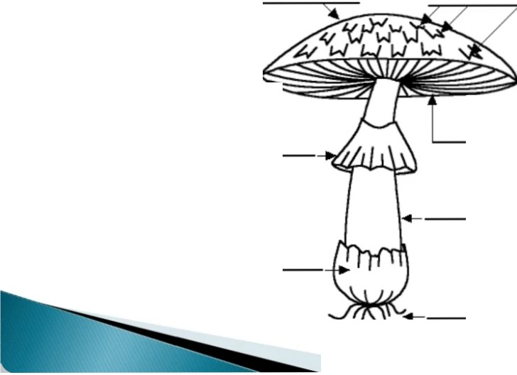
St ruct u re
Cap (Pileus}
Scales
Gills (Lamellae}
Ring (Annulus }
Stem (stape}
Cup (Volva }
Mycelial threads

Slide 6
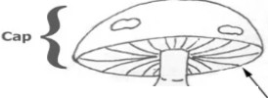


••A mushroom typically consists of a stalk (stipe) and a cap (pileus).
••As the mushroom develops from an underground mycelium and pushes upward, it is protected by a thin membrane which eventually ruptures, leaving fragments on the cap.
••Another membrane, attaching the cap to the stalk, also ruptures, allowing the cap to expand and leavi11g a remnant ring (annulus) on the stalk.
•!Radiating rows of gills are found on the cap's undersurface; these bear the club-shaped reproductive structures (basidia) which form minute spores known as basidiospores, of which a single mushroom may produce millions.
Ring (annulus)
--""'-'
Gills
-Stalk
-
Volva
{universal veil
remnant)
­

Slide 7
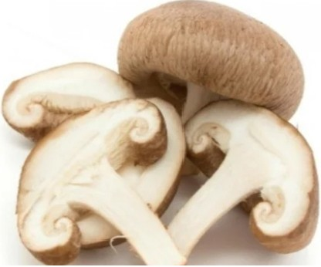
r
W hat Is t he N ut r it iona l V a lue of Mus hroo ms ?
••Mushrooms are low in calories , high in fiber, and contain many important vitamins and minerals. Some also have medicinal properties such as complex carb,ohydrates that strengthen the
The are an excellent source ol protn.in some regions th are known as vegetable meat .for their high protef n content.The contain all the essential amino acids needed .for ur bOd.
Th have a high concentration Ot carbohydrates at 57% and 11f% raw fiber.Most of thOH carbohydrates are complex sugarS that wiU he p you
regulateinsuln ana JugarleveU
The percentage of proteinin dry mushrooms could be between t0% and 30% of the totalmu1hroom weight
becau1e th are tow-gtycemic sugars.

Slide 8
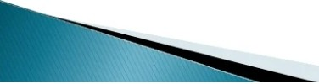
Nutritiona l V a lue of Mus hroo ms
•:• Protein - Most mushrooms have a high protein content, usually around 20-30% by dry weight.
•:• Fiber - Helps lower cholesterol and is important for the digestive system.
•:•vitamin D - Essential for the absorption of calcium.
•:•copper - Aids in helping the body absorb oxygen and create red blood cells.
••selenium - An antioxidant that helps neutralize free radicals, thus preventing cell damage and reducing the risk of cancer and other diseases. Mushrooms
contain more selenium than any other form of produce.
•:• Potassium - An extremely important mineral that regulates blood pressure and keeps cells functioning properly
••other important minerals - Such as phosphorous, zinc, and magnesium.
••Low levels of fat, calories , and sodium
•:• No cholesterol

Slide 9
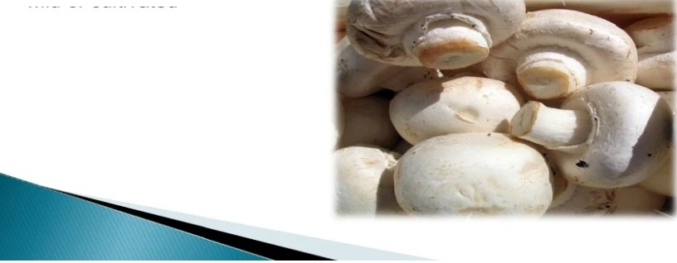
Edible Mus hroom
••Edible mushrooms are consumed by humans for their nutritional value and they are occasionally consumed for their supposed medicinal value.
•• Edibility may be defined by criteria that include absence of poisonous effects on humans and desirable taste and aroma .
••Edible mushrooms include many fungal species that are either harvested wild or cultivated

Slide 10
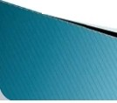

Agaricus bisporus :
:· Also known as bisporus is grown manure.
'the white
cultivated
mushroom.Agar cus
on composted
cereal straw and animal
·:·Agaricus | bisporus is the most | extensively | cultivated
mushroom | in the world , accounting | for 38°/o of | the world
production of cultivated mushrooms.
Volvariella volvacea :
·:· The 'Chinese' or 'paddy straw' mushroom. Volvariella volvacea is a high temperature mushroom grown largely in tropical and subtropical regions of Asia e.g. China, India.
·:·This mushroom can be grown on a variety of agricultural wastes Vo/variella mushrooms account for 16o/o of total production of cultivated mushrooms in the world.

Slide 11
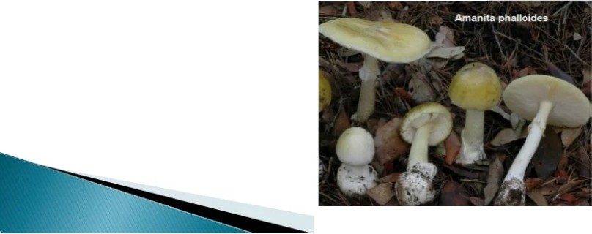
Poisonous Mus h roo m s
•• Poisonous Mushrooms look like edible mushroom in their morphology and lifecycle. However They can be distinguished by following features:
•• Brightly coloured fruit bodies.
•• Greenish tinge on gills and Yellow-Green spores .
•• Pink coloured spores in gills.
•• Presence of Vulv a and Annulus on the Stalk.
•• Oozing of milky or coloured latex at damaged portions
••Unpleasant odour
E.g. Amanita phalloides Tricholoma muscarium

Slide 12
Po iso nous Mus hroo ms

Slide 13
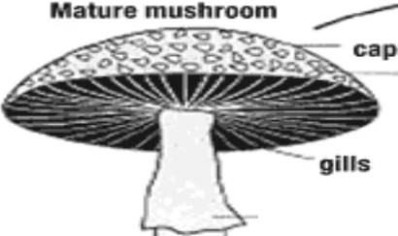
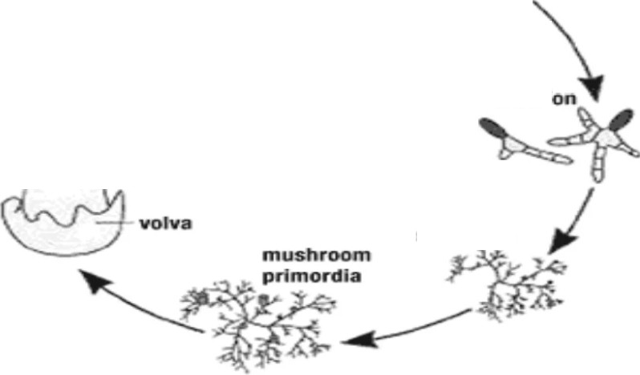
Mushroom Lif ecyc le
b... .s..p.o.res
'
scales
spore
germinat on
annulus (ring)
sflpe (stem)
mycellum

Slide 14
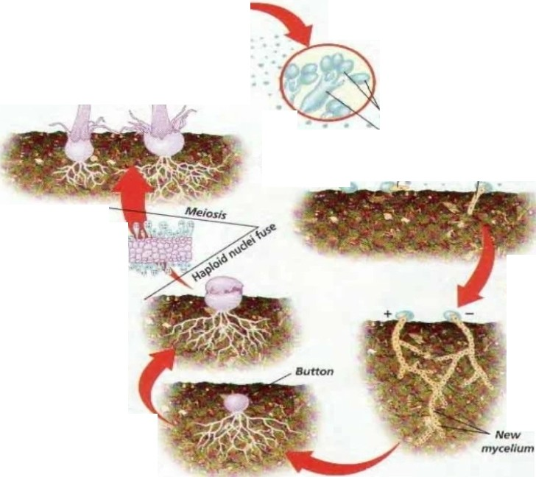


0 Stipe and cap Above ground,a mushroom consists of a stipe that supports a cap.
f) Gills The undersides of most caps have thin sheets of tissue, called gills, which contain basidia
Cap -..........
that produce bas1diospores.Wind
disperses mature spores.
I
Gilfs
•
@ Spore germination
When a basid1ospore
-srJpe -....,.
germl1nates,It pro­ duces hyphae of either
Basidfospores Basidium
mating strain + or -
•
•
Basldlosp
ore
+ Matfng type
I
- Mating type
""'
Basldfa\
0Spore production
In the basldla. haploid
nuclei fuse.Meiosis occurs, producing four haploid nuc:lei that develop into basidlospores.
0 Hyphae fusion When different hyphae meet. they fuse and form a new mycelium containing cells
with two haploid nuclei.
eButton formation The mycellum forms a compact mass, a button,iust below the soil's surface.A button develops into a stipe and cap

Slide 15


K ey step s i n
m u s h roo m p 1,. od u c t i on
:· The key generic steps in mushroom production - a cycle that takes between one to three months from start to finish depending on species - are:
:·identifying and cleaning a dedicated room or building in which temperature, moisture and sanitary conditions can be controlled to grow mushrooms in choosing a growing medium and storing the raw ingredients in a clean place under cover and protected from rain.

Slide 16
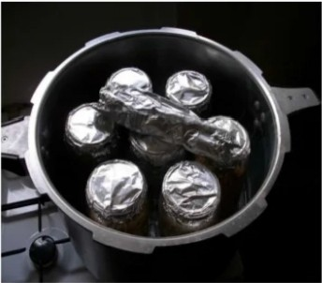
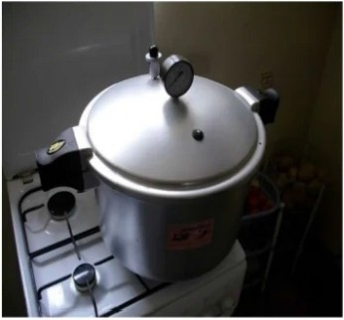


:·pasteurizing or sterilizing the medium and bags in which, or tables on which , mushrooms will be grown (to exclude other fungi that would compete for the same space - once the selected fungi has colonized the substrate it can fight off the competition).

Slide 17

!·seeding the beds with spawn (spores from mature mushrooms grown on sterile media);
:·maintaining optimal temperature, moisture, hygiene and other conditions for mycelium growth and fruiting, which is the most challenging step; adding water to the substrate to raise the moisture content since it helps ensure efficient sterilization;
:·harvesting and eating, or processing, packaging and selling the mushrooms;
:·cleaning the facility and beginning again.

Slide 18


(i) Preparation or procu rement of
pa,vn:Molher spaw n can be procu red fron1any 111ushroo1n
research ce nter and pri n1ary cu ltu re of spawn can be prepa red by follow ing (Mush room Gro,ve rs Handbook)
procedu re:
I. Select good quality jowar or wheat grain free fron1pe ·t and 1nould .
? Boil the grains su bmerged i n clean water for 20-30 minutes. \V hen che grains beco me
ofl, ren1ove and pread evenly on a colton cloth to drain oul lhe waler and cool lhe
gra. s.
in
Mix 3o/o chalk powder (30g/ kg of grain) for adjusting lhe pH and to keep the grains loo e.
Fi II '750gms of grain in cleaned and dried glucose bottle of 500n1I capacity or propylene bag and p lug t he rnouth of lhe boll le lighl ly w it h non-ab orbenl cotton.
Steri l ize the bott les i n autoclave by exposi ng to 12 1°C and 151bs pres u re/sq inch tor 20 rni nlil tes. After coolin g. transfer the bottle to inocu lation chamber.
Transfer fe\v grain. w i t h mycelial gro\vlh into sleri ized su b t rate bott le u nder asepl ic cond ition and plug it \vit h cotton.
Shift t he inocu laled bollle lo spaw n ru nning roo1n having lemperalu re range of 25-30°C.

Slide 19


